Slide 1
Group 3: AI Based Models For Classification and Regression
Nnamdi Ogbonnaya Odii
Jan Schiefer
Bhagyashree Zaware
11160333
11106997
11160161

Slide 2
Agenda
Random Forest Theory
Neural Network Theory
Implementation Details
Classification
Regression

Slide 3
Random Forest: Classification & Regression
What is Random Forest?
Random forest is a supervised ensemble learning method for classification and regression that operates by constructing a multitude of decision trees at training time. For classification tasks, the decision of the majority of the trees is chosen by the random forest as the final decision. For regression tasks, the mean or average prediction of the individual trees is returned.

Slide 4

Classification / Regression
The Model:
How it Works

Slide 5
Random Forest: Classification & Regression
Important Terms in Random Forest
Decision Tree: This is a tree-shaped diagram used to determine a course of action. Each branch of the tree represents a possible decision, occurrence or reaction.
Ensemble Learning: Random forest uses ensemble learning method in which the predictions are based on the combined results of various individual models.
Bagging: This is a process of training a bunch of individual models in parallel and each model is trained by a random subset of the data.
Bootstrapping: A process of creating n-subsets of equal sizes from your dataset through random selection with replacement.
Out-of-Bag Dataset: This is the entry that did not end up in the bootstrapped dataset, used for testing. The accuracy of RF can be measured by the proportion of out-of-bag samples that were correctly classified by the algorithm.

Slide 6
Random Forest: Classification & Regression
Hyperparameters: Hyperparameter tuning is about finding a set of optimal hyperparameter values which maximizes the model’s performance, minimizes loss and produces better outputs.
n_estimators: This is the number of trees in the forest.
max_depth: The longest path between the root node and the leaf node.
min_sample_split: The minimum number of samples required to split an internal node: Default = 2
bootstrap: Method for sampling data points (with or without replacement)
Default = True
min_samples_leaf: Specifies the minimum number of samples that should be present in the leaf node after splitting a node. Default = 1
max_features: This is the number of features to consider when looking for the best split.

Slide 7
Classification: Random Forest
What is Classification?
Classification is a supervised machine learning process by which a trained algorithm predicts the class (target, label or category) of a new set of input data. Depending on the number of classes, a classification problem can be either binary or multi-class. The most common classification problems are – speech recognition, face detection, handwriting recognition, document classification, etc. Common classification algorithms include: K-nearest neighbor, decision trees, naive bayes, random forest, support vector machine and artificial neural networks.

Slide 8
Regression : Random Forest
What is Regression?
Regression is a form of supervised machine learning technique in which algorithms are trained – using labelled input and output data - to understand the relationship between independent variables(or features) and a dependent variable or outcome. Afterwards, the model can be used to predict the outcome of new and unseen input data, or to fill a gap in missing data.
Machine learning regression finds applications in forecasting continuous outcomes such as stock prices, success or failure of future retail sales, customer or user trends, creating time series visualizations etc.
Common regression techniques include simple linear, multiple linear regression(depending on the number of features) and logistics regression(depending on if the dependent variable can have one of two values, such as true or false, success or failure).

Slide 9
Classification : Random Forest
Advantages:
It overcomes the problem of overfitting by averaging or combining the results of different decision trees.
Random Forest algorithms maintain good accuracy even when a large proportion of the data is missing.
Random forests work well for a large range of data items than a single decision tree does.
It can be used for both classification and regression tasks.
It runs efficiently on large databases.

Slide 10
Classification : Random Forest
Disadvantages:
Construction of Random forests are much harder and time-consuming than decision trees.
Low interpretability: Random forest is a black box. It is difficult to understand how and why it came to a particular decision.
The process of creating hundreds or thousands of trees used by Random forest in making decision slows down the process, hence making it inefficient for real time forecasting.
Random forest may not get good results for small data or low-dimensional data (data with few features). Since the randomness becomes greatly reduced. Processing high-dimensional data and feature-missing data are the strengths of random forest.
Random forest may overfit for data with much noise.

Slide 11
Agenda
Random Forest Theory
Neural Network Theory
Implementation Details
Classification
Regression

Slide 12
Neural Networks (NN)
h₀
What are they?
Inspiration - biological neural networks
How do they learn?
supervised learning?
x₀
y₀
x₁
y₁
x₂
y_{k}
x_{i}
h_{j}
Input
layer
Hidden
layer
Output
layer

Slide 13
h₀
w₀
w₁
w₂
w_{i}
x₀
y₀
x₁
y₁
x₂
y_{k}
x_{i}
h_{j}
w₀.x₀ + w₁.x₁ + w₂.x₂ + … w_{i}.x_{i}
Input
layer
Hidden
layer
Output
layer

Slide 14
NN terms and hyperparameters
h₀
The perceptron
x₀
y₀
x₁
y₁
x₂
y_{k}
x_{i}
h_{j}
Input
layer
Hidden
layer
Output
layer

Slide 15
h₀
x₀
y₀
x₁
y₁
x₂
y_{k}
x_{i}
h_{j}
Input
layer
Hidden
layer
Output
layer

Slide 16
NN terms and hyperparameters
h₀
The perceptron
Hidden layer
Activation function
Introduce non-linearity
sigmoid, tanh, ReLU, and softmax
Epoch
The learning cycle
Learning rate
Step size for learning
Optimizer
SGD, Adam, Adagrad, RMSProp
x₀
y₀
x₁
y₁
x₂
y_{k}
x_{i}
h_{j}
Input
layer
Hidden
layer
Output
layer

Slide 17
Implementation steps
Define the problem
Classification or regression?
Data collection and pre-processing
To remove missing values, outliers or noise
Splitting the data into training, test and validation datasets
Choose architecture and build model
No. Of layers, type of activation function, optimizer
Define input, output layers and compile the model
Train the model
Training using chosen hyperparameters
Monitor performance to detect overfitting or underfitting

Slide 18
Implementation steps continued…
Evaluate the model
Evaluate performance with test data
Metrices: Accuracy, r2 score, mse
Tune the model
Adjust hyperparameters and architecture
Deploy the model
Integrate in production

Slide 19
NN In Classification v/s Regression
Classification
Regression
Goal: To assign an input to one of several predefined categories or classes
Activation function: softmax
Normalizes the outputs so that they represent probabilities of belonging to each class
Loss function: categorical cross-entropy
measures the difference between the predicted probabilities and the true labels
Goal: To predict a continuous numerical value, such as energy consumption
Activation function: linear activation function (typically)
Produces a single output value
Loss function: Mean squared error
Measure the difference between the predicted values and the true

Slide 20
Agenda
Random Forest Theory
Neural Network Theory
Implementation Details
Classification
Regression

Slide 21
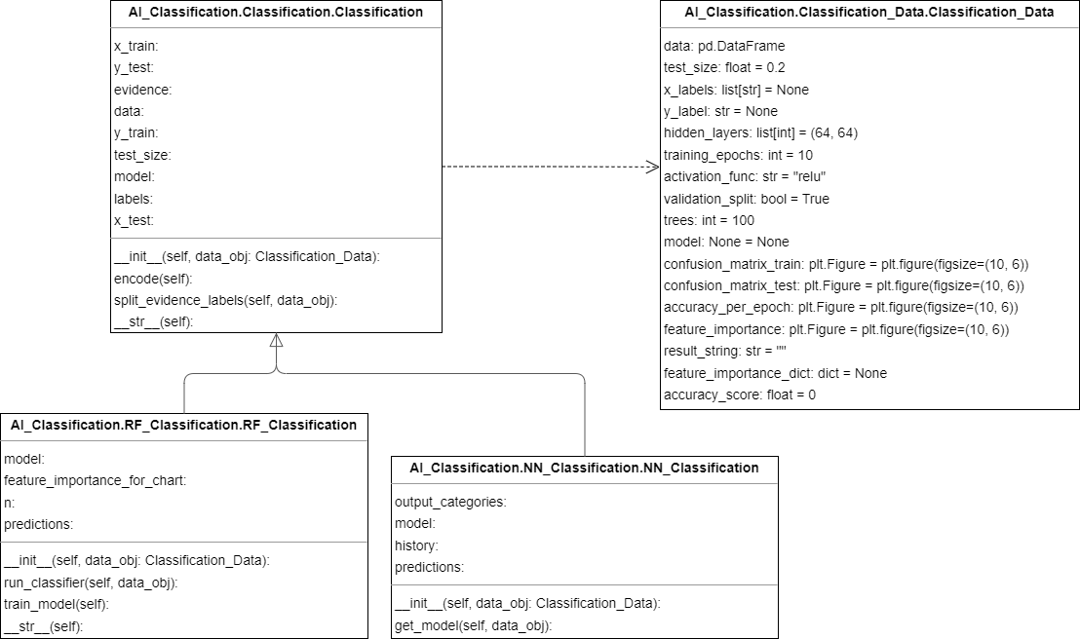
Classification – Class Diagram

Slide 22
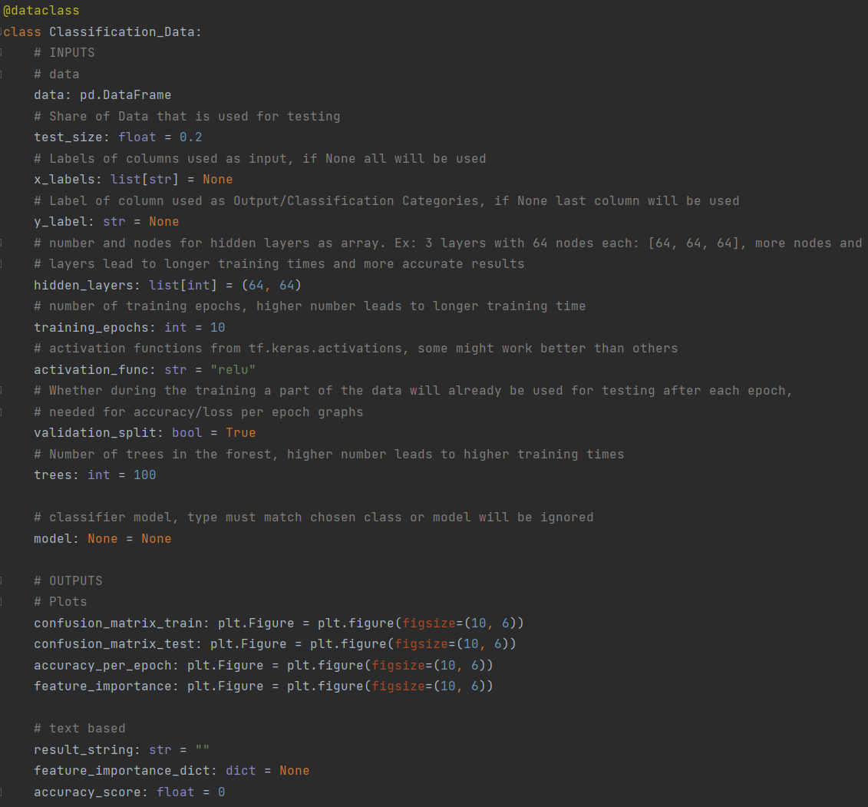
Classification - Data
Handles all In- and Outputs
Only required variable: data
User inputs
Trained model for the user to download or upload
Output plots
Text based results

Slide 23
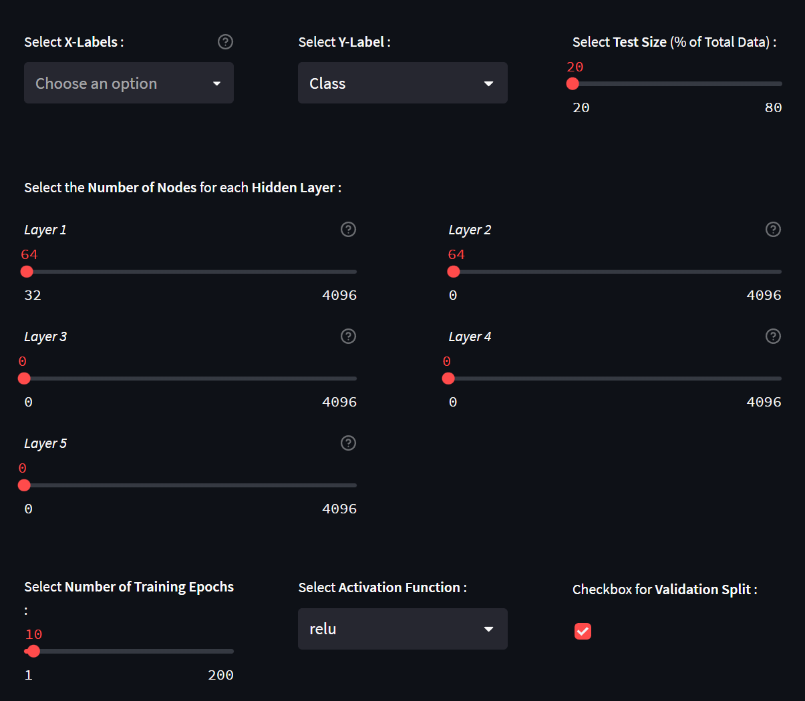
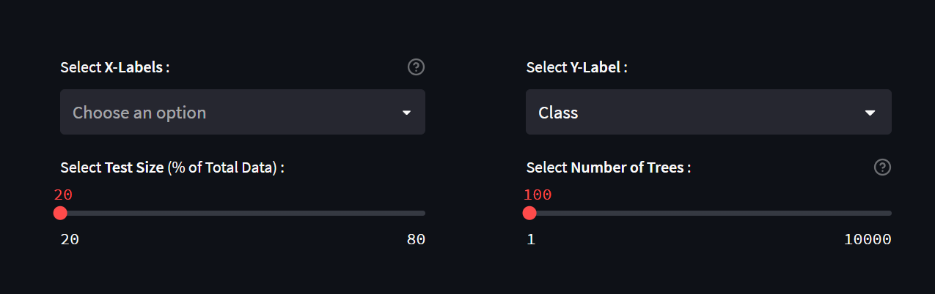
Classification – GUI / Inputs
Neural Networks
Random Forest

Slide 24
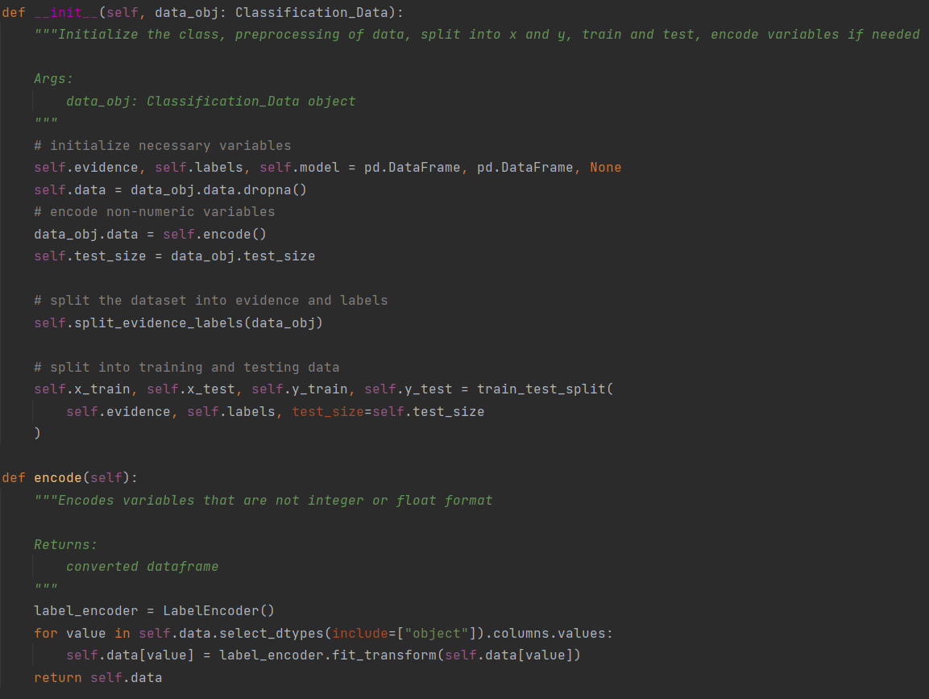
Classification Superclass
Initializes needed variables
Converts str data to integer values using LabelEncoder
Splits Data into Evidence and Labels
Includes method for plotting confusion matrices

Slide 25
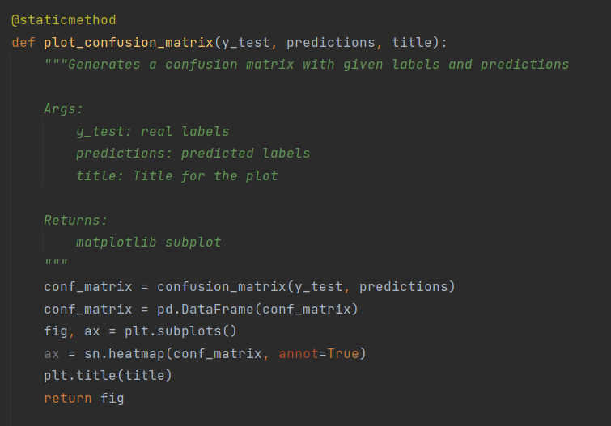
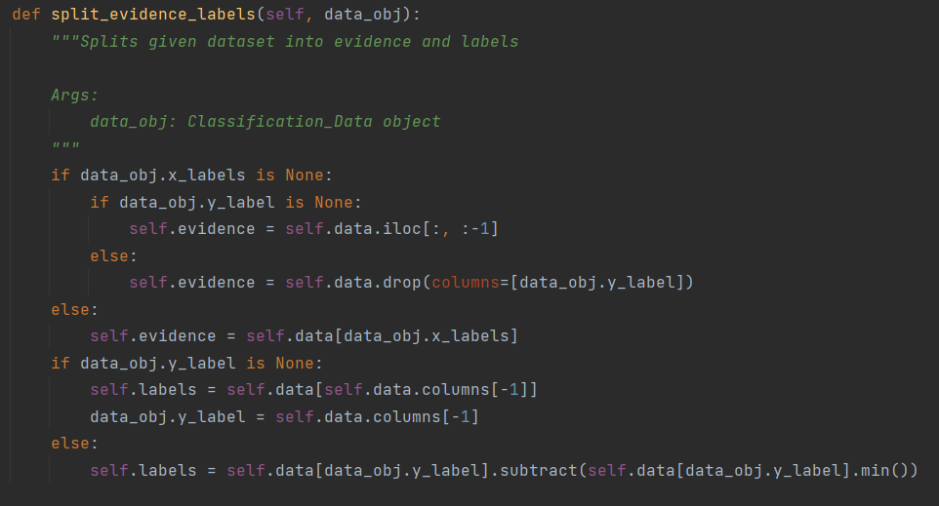
Classification Superclass

Slide 26
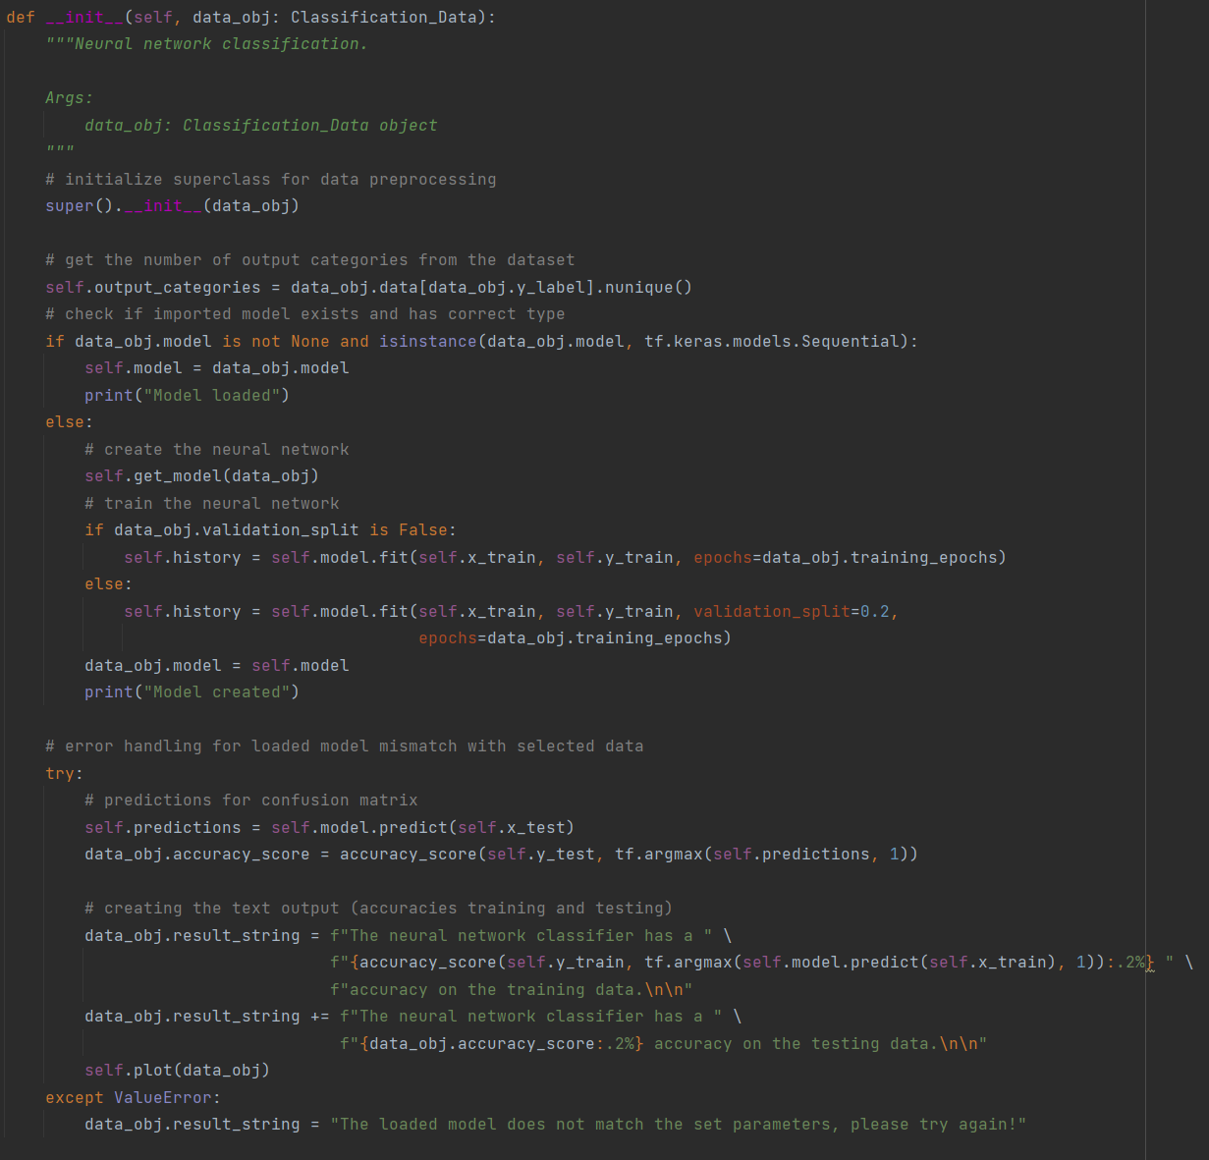
Neural Network Classifier
Initialize superclass & variables
Get output categories from dataset
Check if user provided a model
Create and train new model
Make predictions on training & testing data
Evaluate Results
Plot results

Slide 27
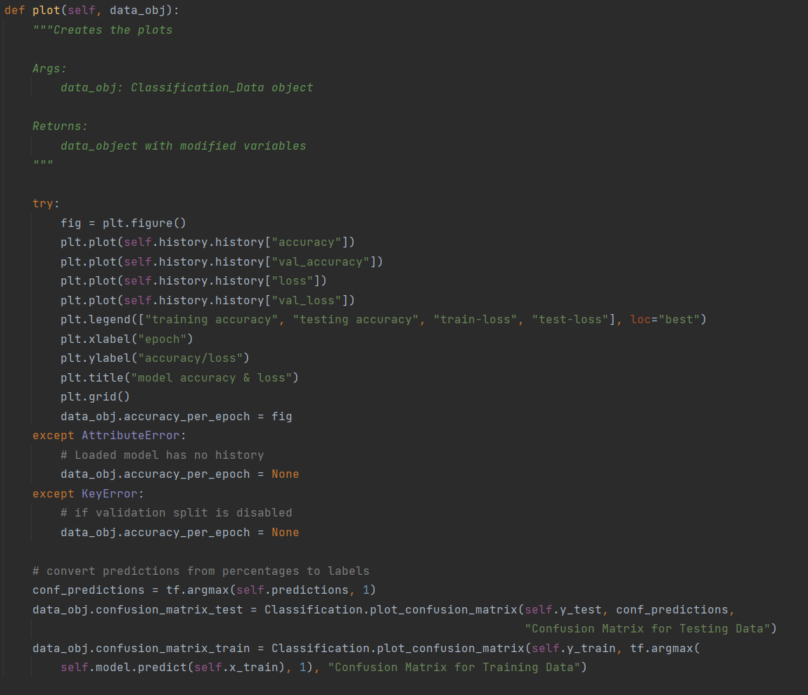
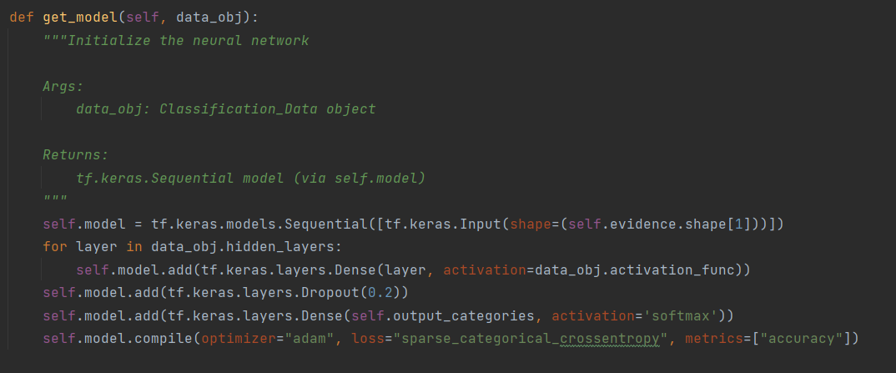
Neural Network Classifier

Slide 28
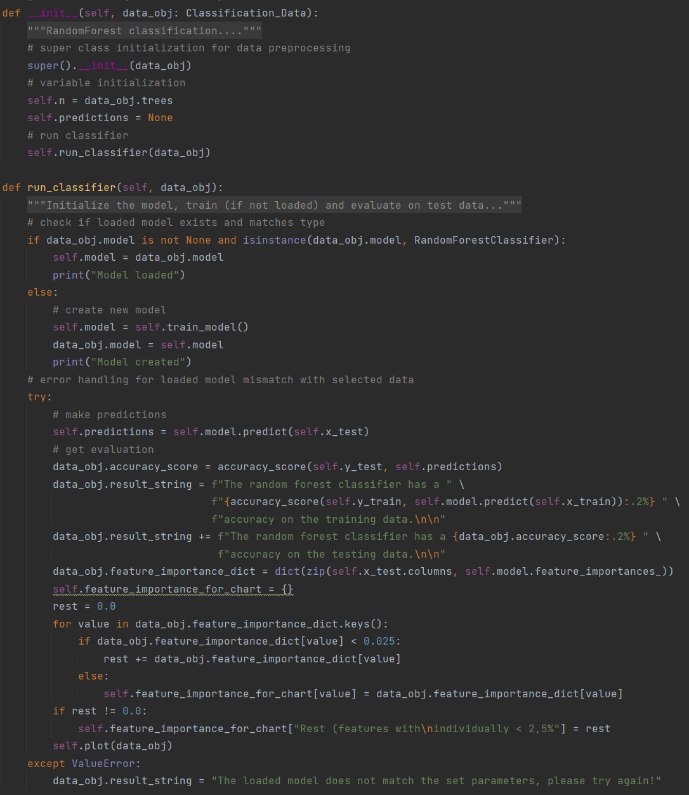
Random Forest Classifier
Initialize superclass & variables
Check if user provided a model
Create and train new model
Make predictions on training & testing data
Evaluate Results
Plot results

Slide 29
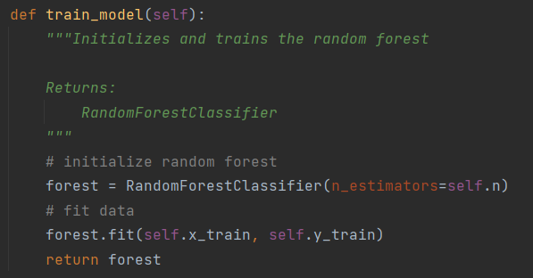
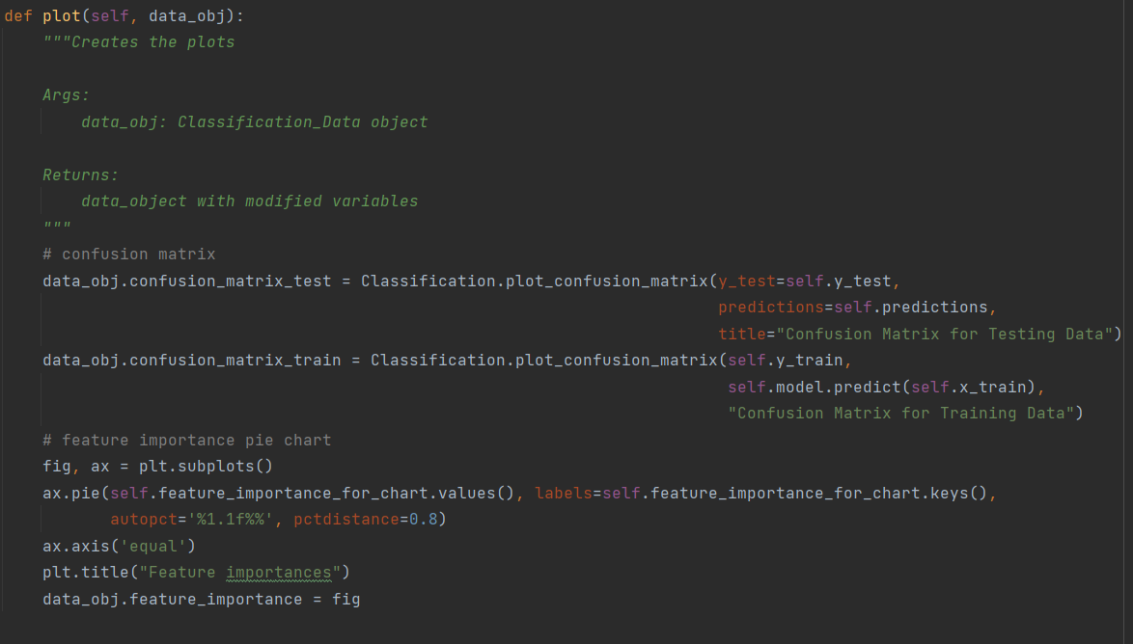
Random Forest Classifier

Slide 30
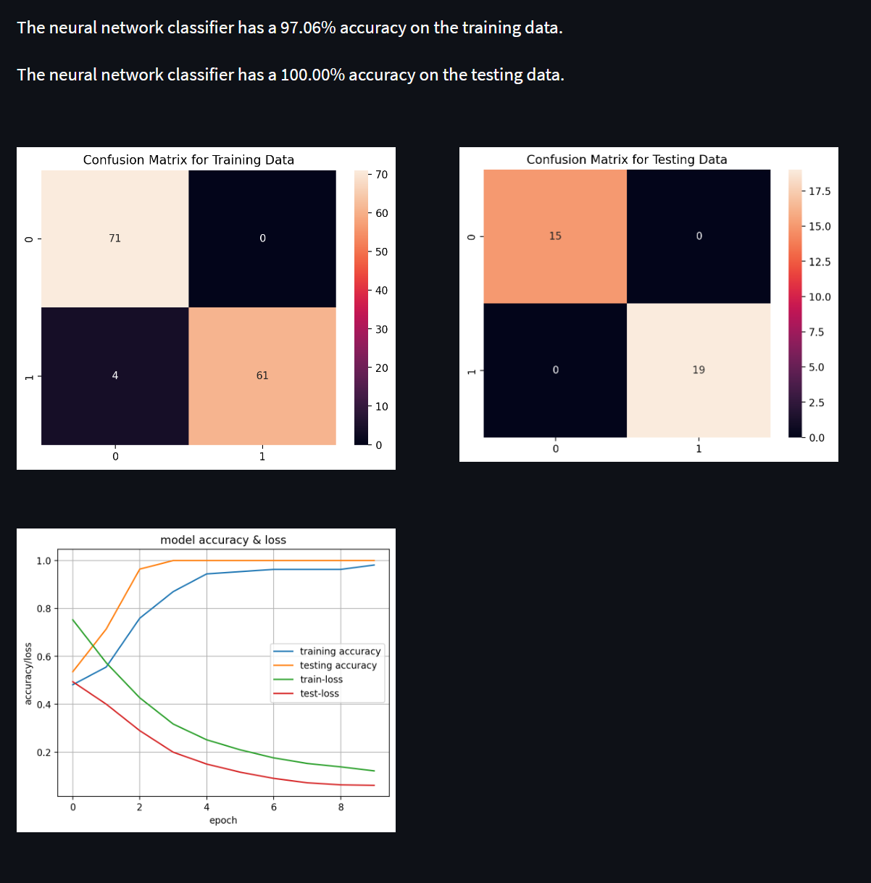
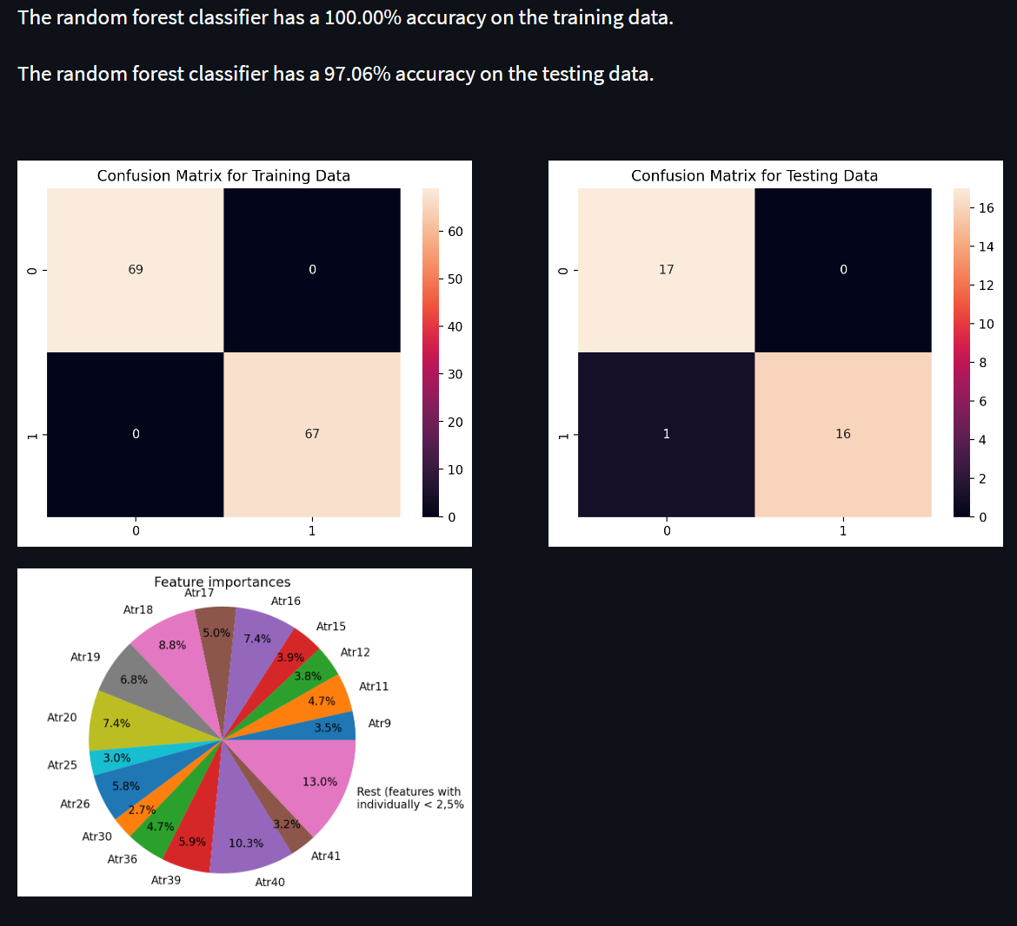
Classification – GUI / Outputs
Neural Network
Random Forest

Slide 31
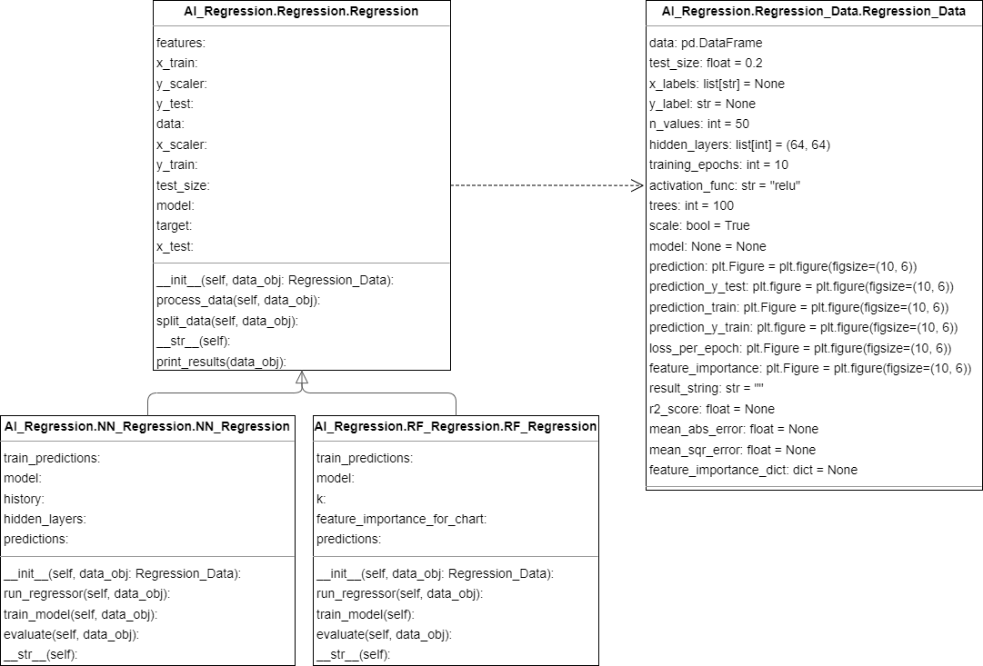
Regression – Class Diagram

Slide 32
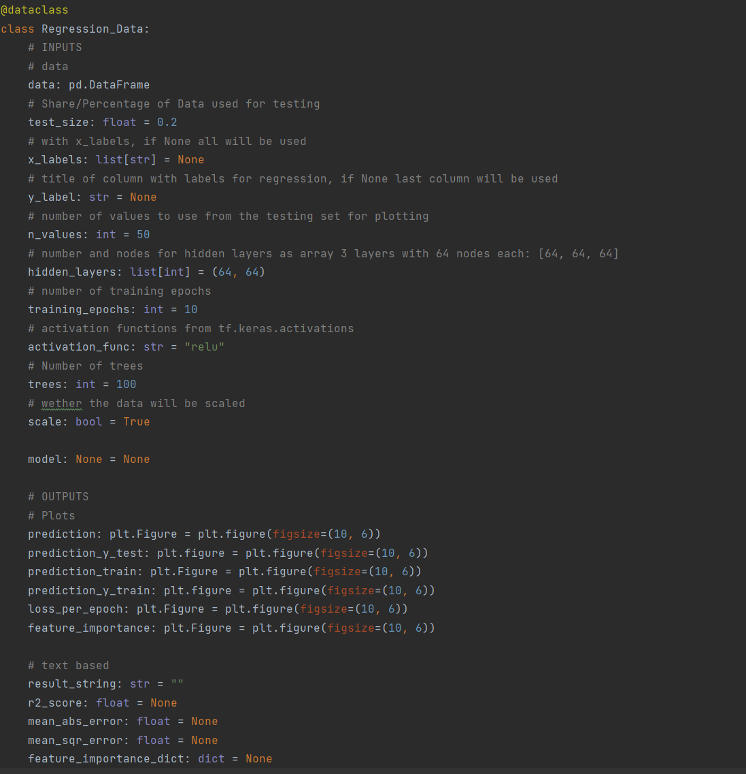
Regression - Data
Handles all In- and Outputs
Only required variable: data
User inputs
Trained model for the user to download
Output plots
Text based results

Slide 33
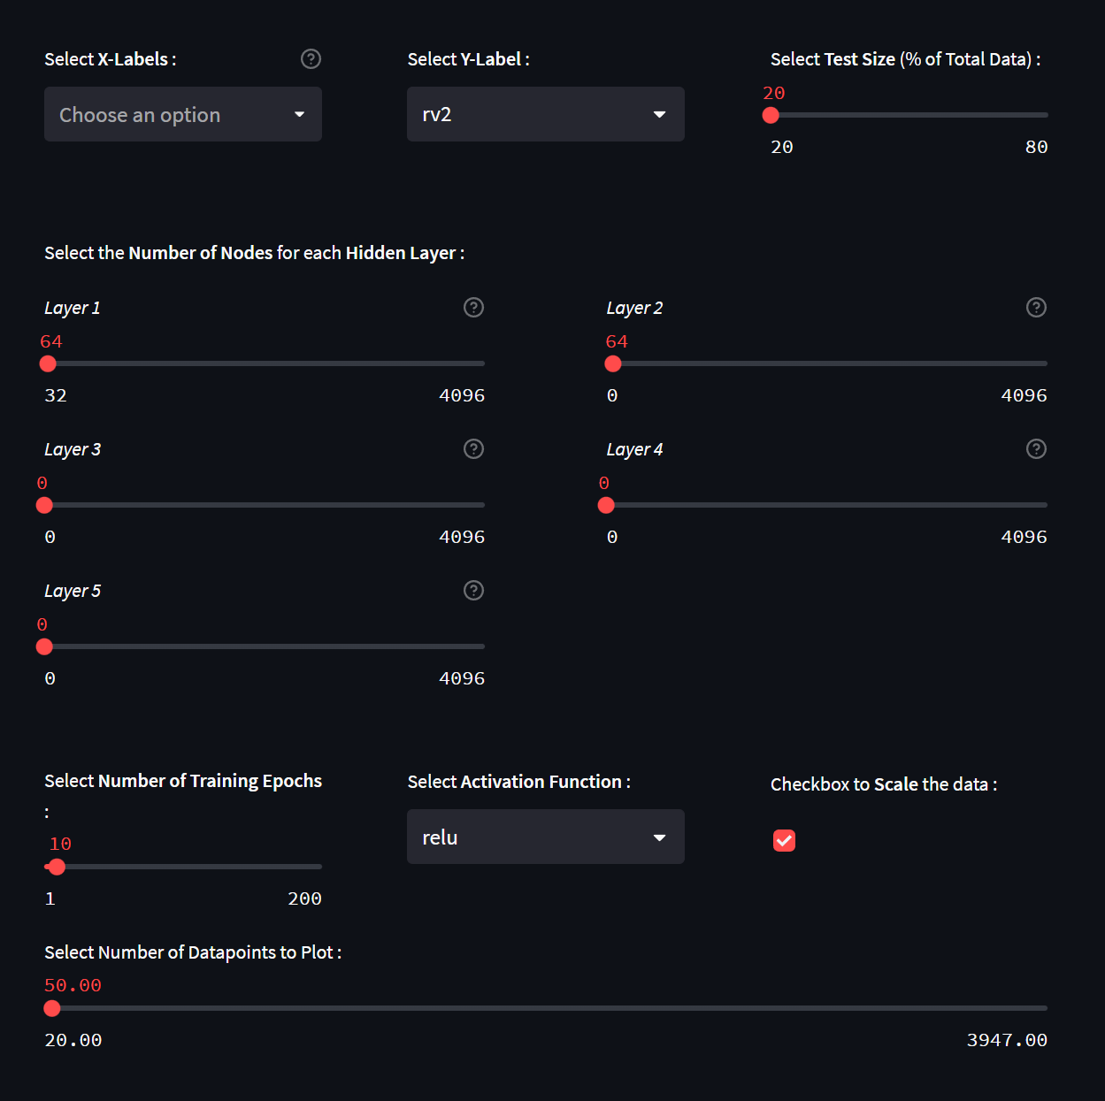
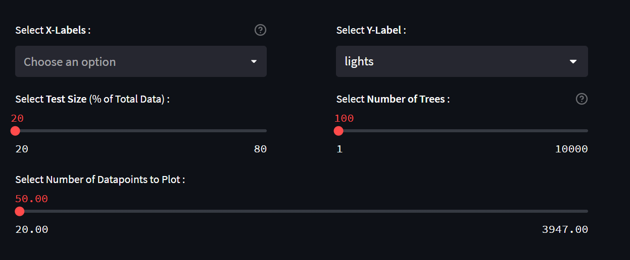
Regression – GUI / Inputs
Neural Network
Random Forest

Slide 34
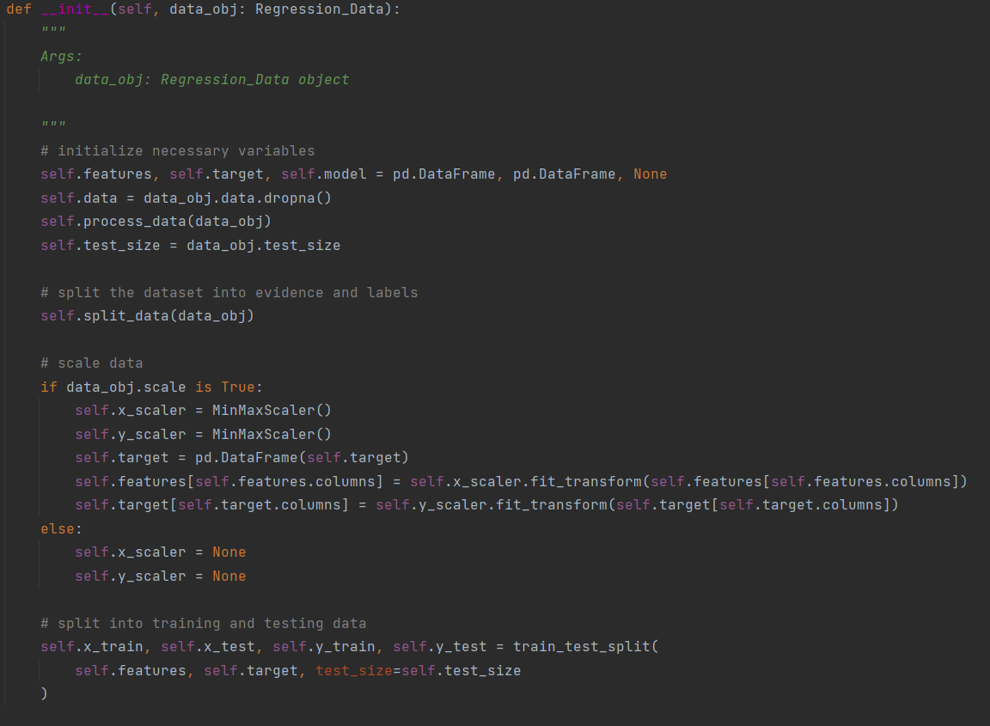
Regression Superclass
Initializes needed variables
Converts datetime data into year, month, day, hour, minute if possible
Scales the data (if the user selected it)
Splits Data into Features and Target
Includes method for generating result string
Includes method to plot prediction graphs

Slide 35
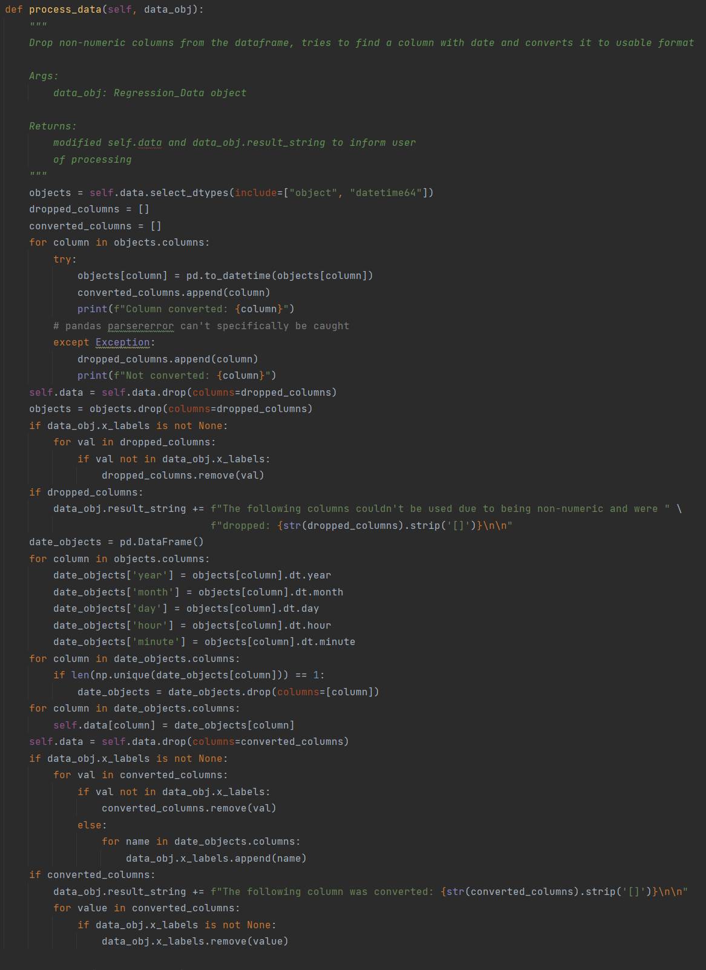
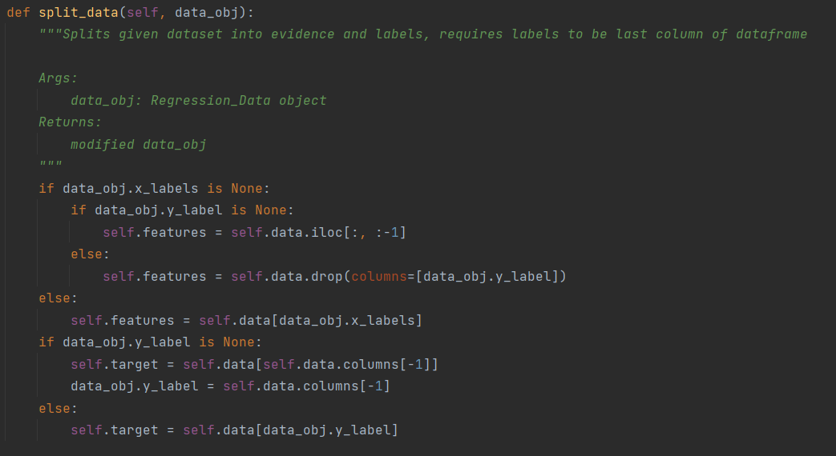
Regression Superclass

Slide 36
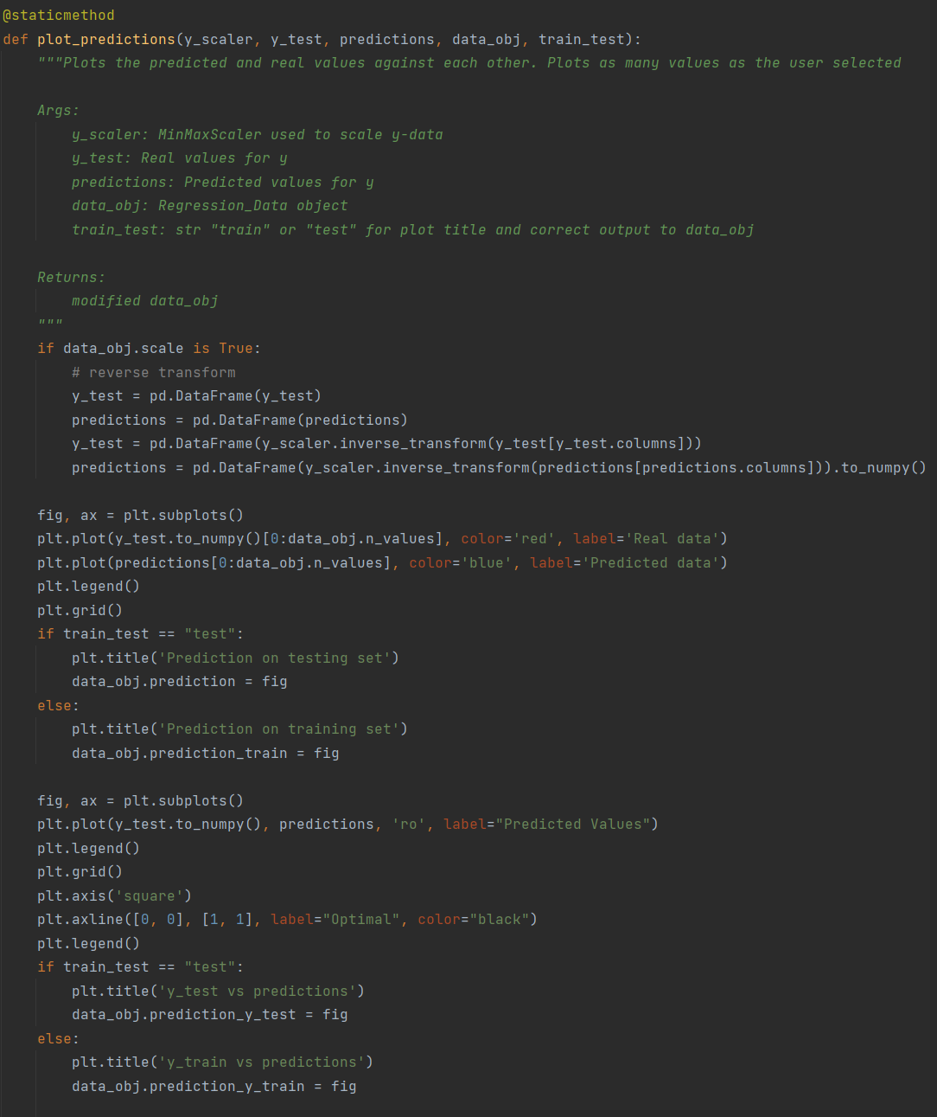
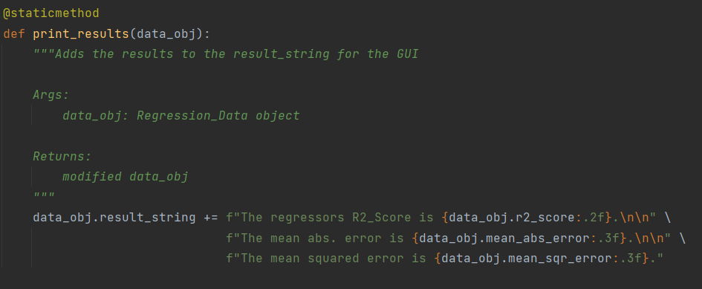
Regression Superclass

Slide 37
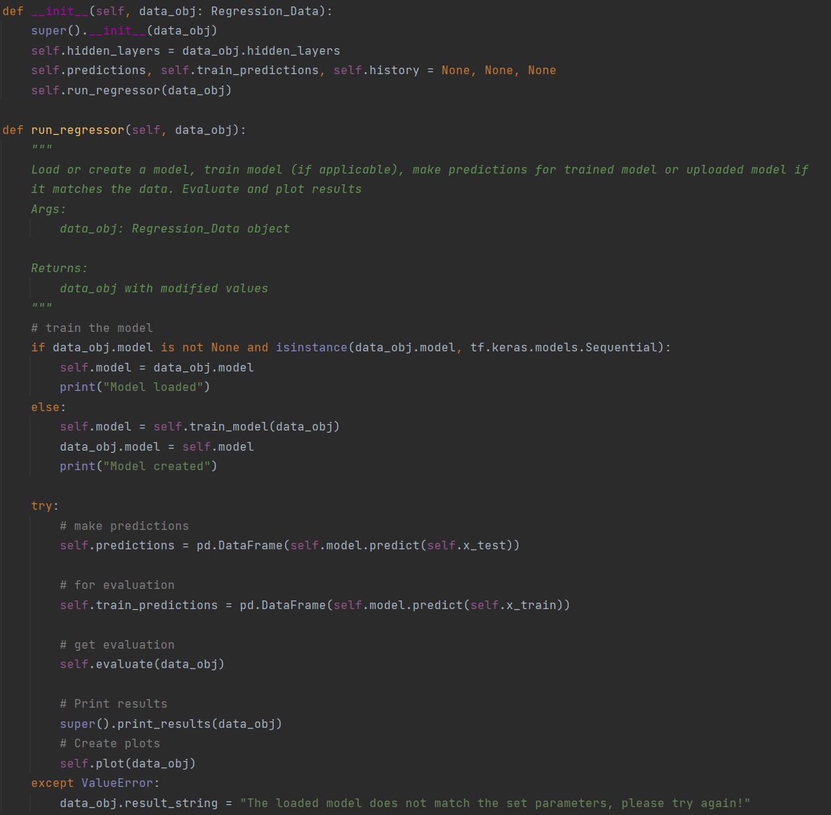
Neural Network Regressor
Initialize superclass & variables
Check if user provided a model
Create and train new model
Make predictions on training & testing data
Evaluate Results
Plot results

Slide 38
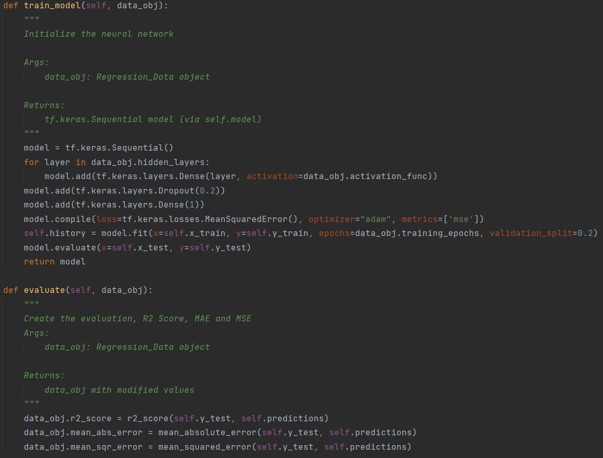
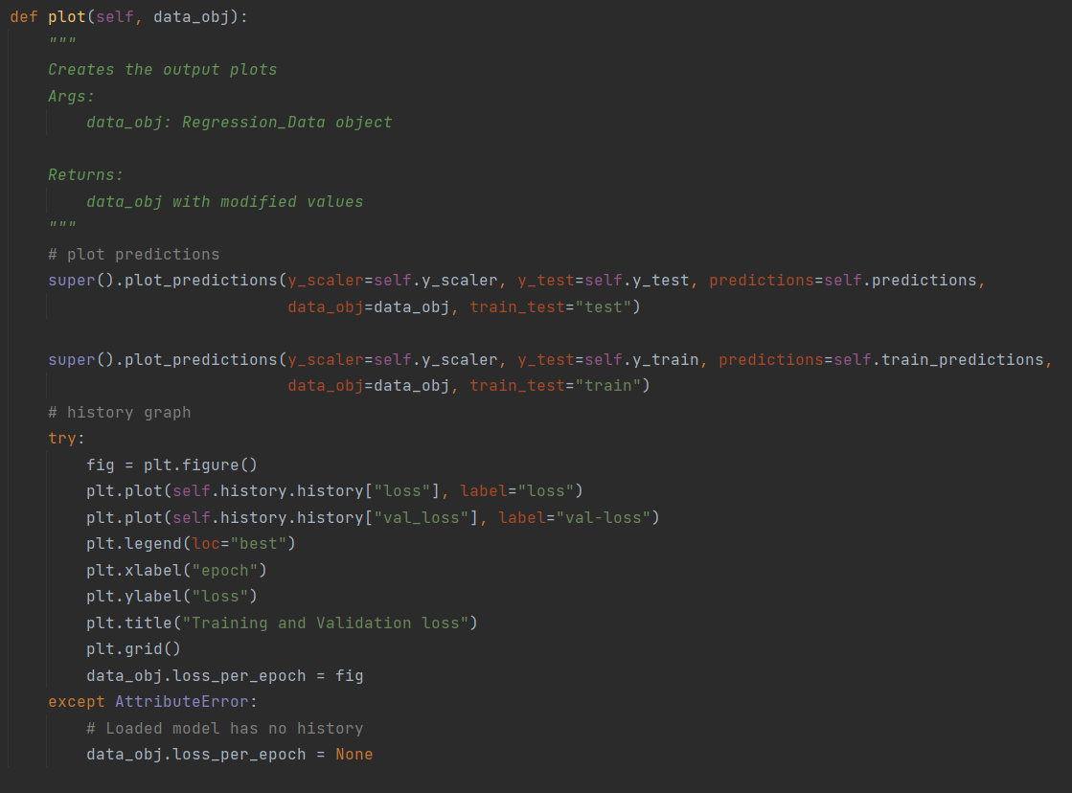
Neural Network Regressor

Slide 39
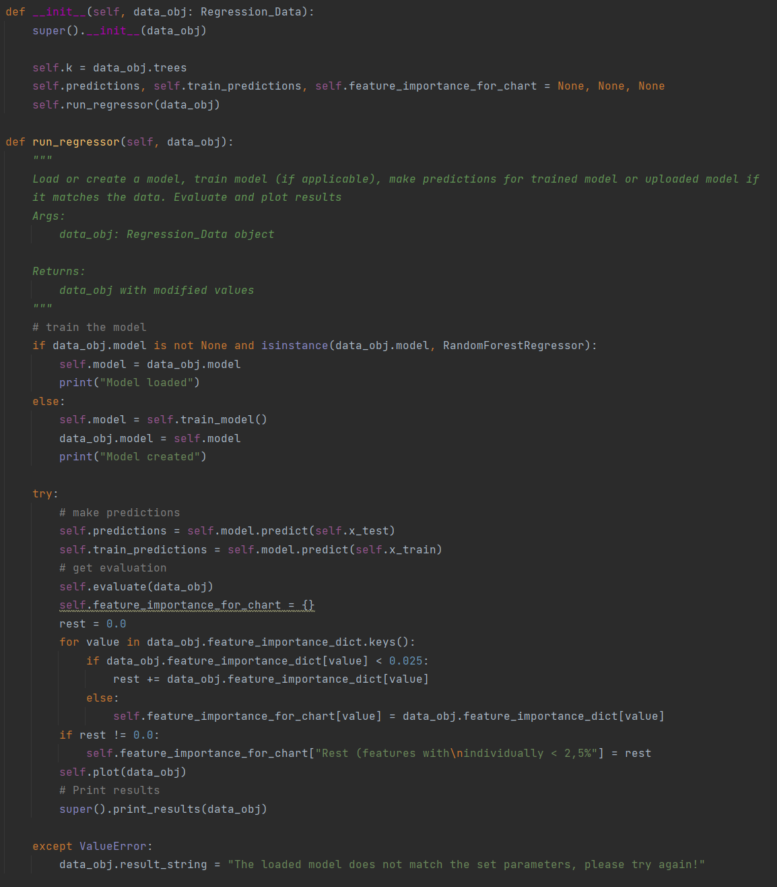
Random Forest Regressor
Initialize superclass & variables
Check if user provided a model
Create and train new model
Make predictions on training & testing data
Evaluate Results
Plot results

Slide 40
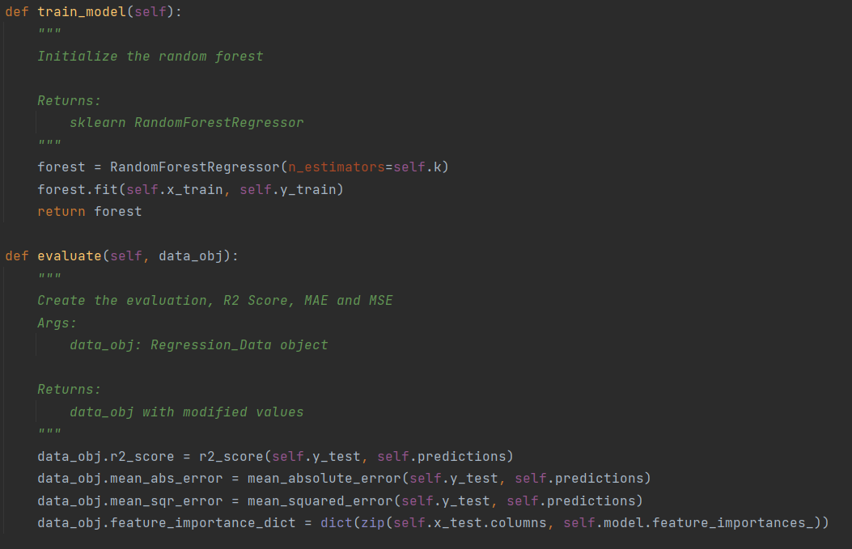
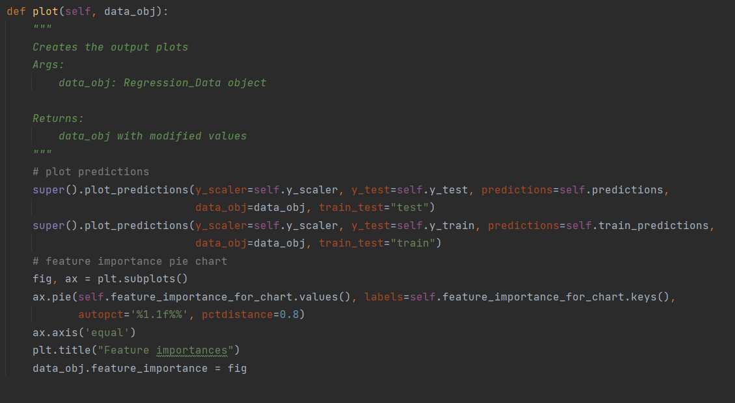
Random Forest Regressor

Slide 41
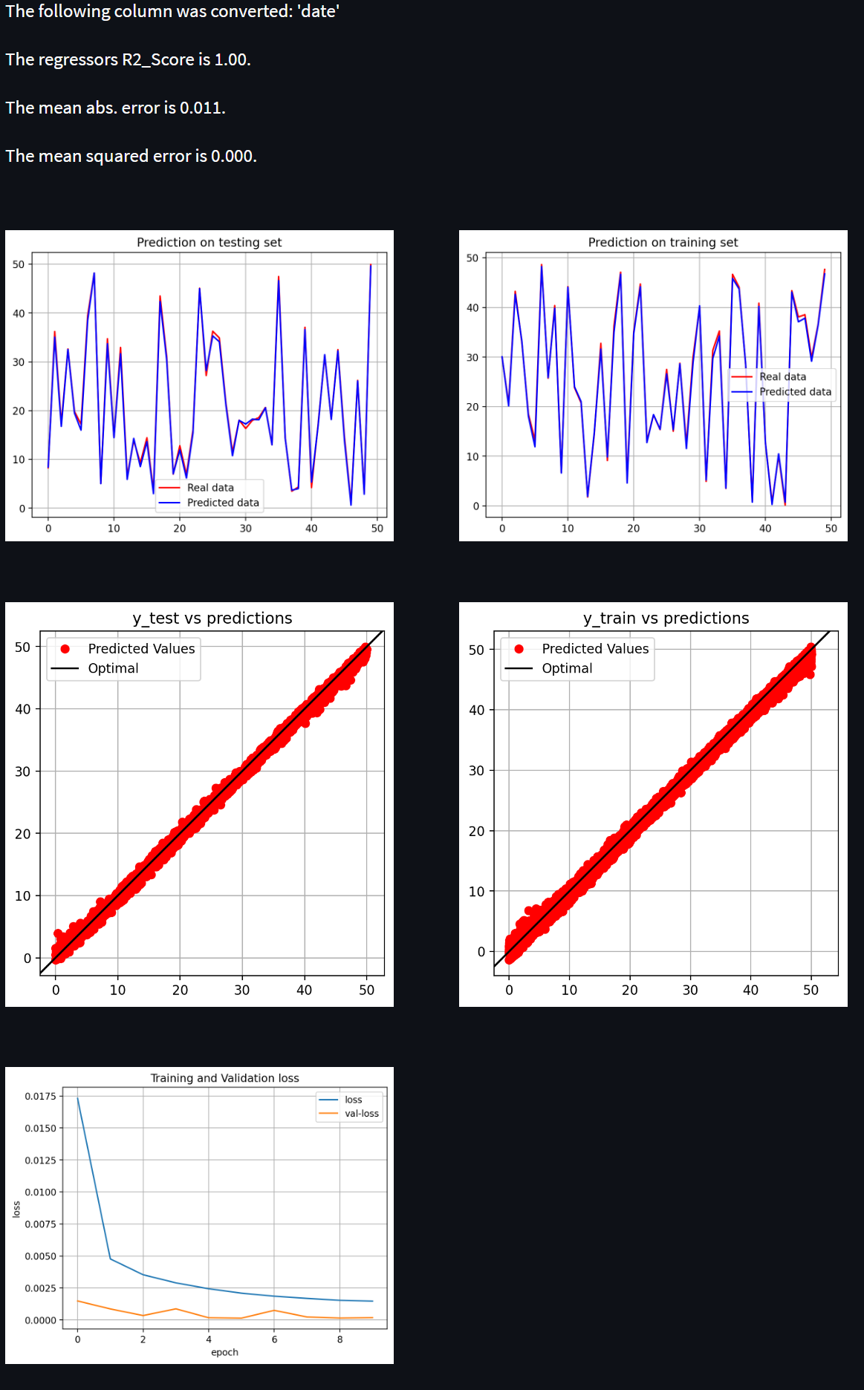
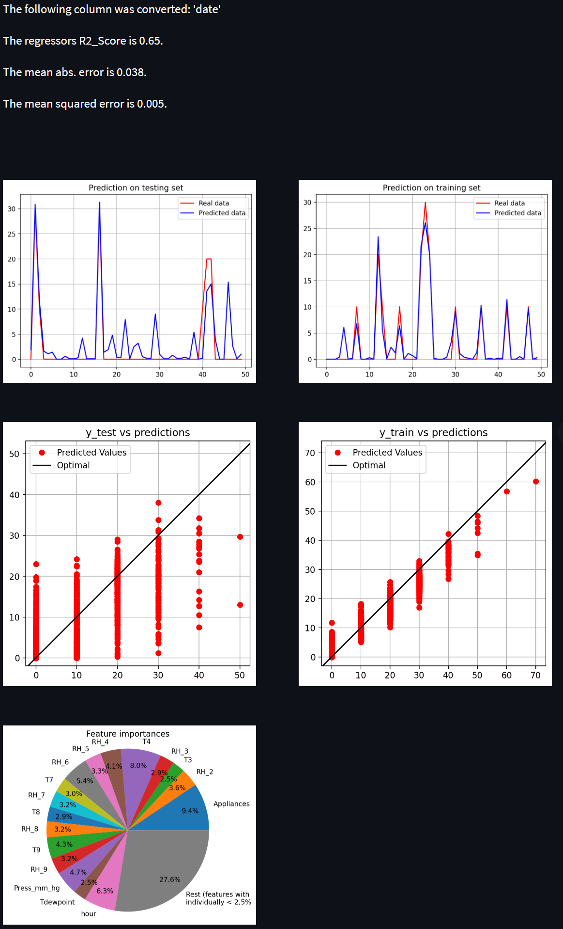
Regression – GUI / Outputs
Neural Network
Random Forest

Slide 42
Links
Github: https://github.com/jan-of-us/OOP_22_AI_NN
Documentation: https://oop-22-ai-nn.readthedocs.io/en/latest/
Github overall project:
https://github.com/YuganshuWadhwa/Data-Science-and-Visualization-Application
Documentation overall project:
https://mait-oop22-23-documentation.readthedocs.io/en/latest/

Slide 43
Questions?

